Slide 1
E-retail factors for customer activation and retention: A case study from Indian e-commerce customers

Slide 2
Customer satisfaction has emerged as one of the most important factors that guarantee the success of online store; it has been posited as a key stimulant of purchase, repurchase intentions and customer loyalty. A comprehensive review of the literature, theories and models have been carried out to propose the models for customer activation and customer retention. Five major factors that contributed to the success of an e-commerce store have been identified as: service quality, system quality, information quality, trust and net benefit. The research furthermore investigated the factors that influence the online customers repeat purchase intention. The combination of both utilitarian value and hedonistic values are needed to affect the repeat purchase intention (loyalty) positively. The data is collected from the Indian online shoppers. Results indicate the e-retail success factors, which are very much critical for customer satisfaction.

Slide 3
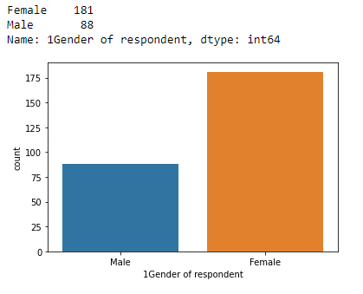
Most of the Female are doing online shopping

Slide 4
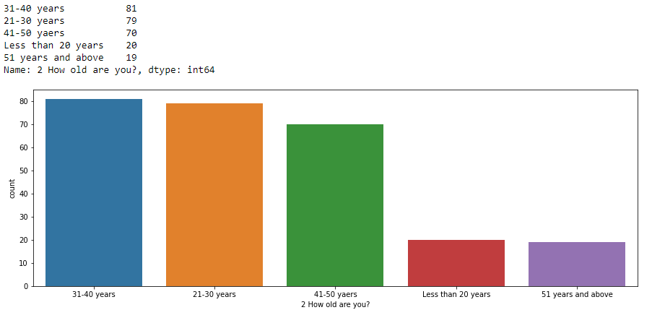
Most of the customers aged between 21-50 years are doing online shopping.

Slide 5
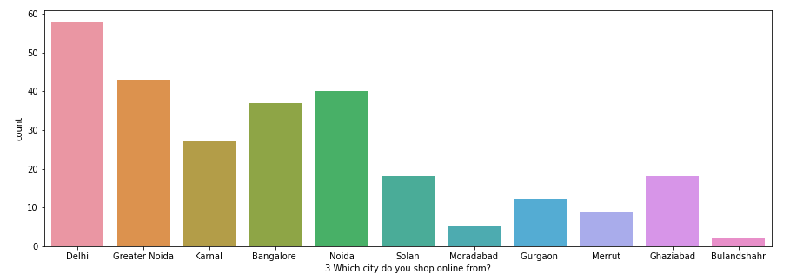
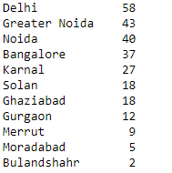
Most of the online shopping customers are from NCR. So, need to focus on other cities to increase the sale.

Slide 6
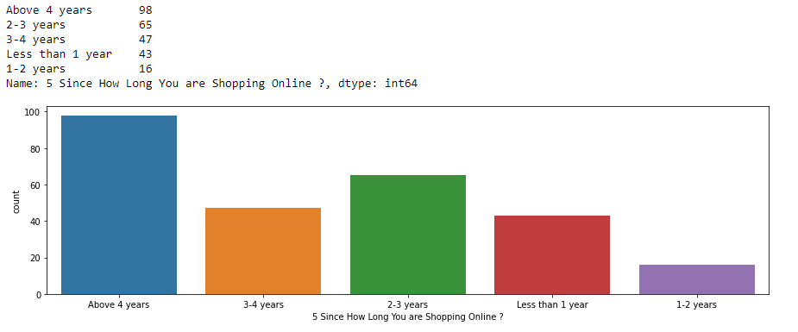
Every age customer doing online shopping but Most of the customers are doing shopping more than 4 years. Let's check the age effect on it

Slide 7
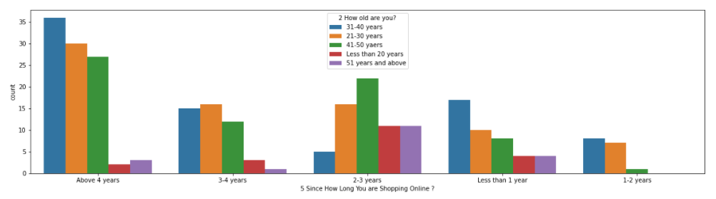
Now again it's clear that most of aged 21-50 years customers giving preference to online shopping.

Slide 8
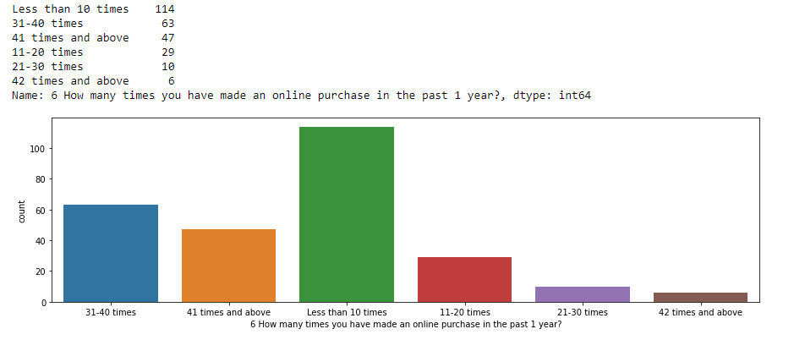
It seems that shopping trend is very low in last year. So, need to focus this type of customer.

Slide 9
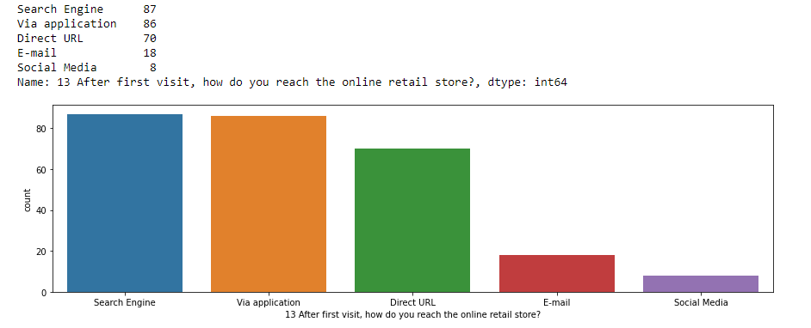
All fields are looking good but Social Media is not playing good role in online shopping.
We need to focus on Social Media Platform to increase the sale.

Slide 10
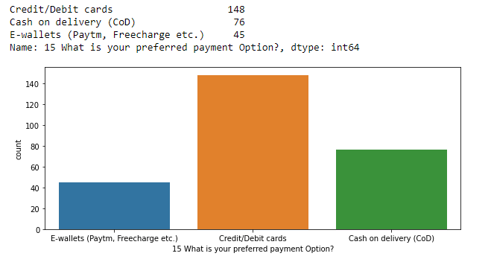
Most of the customers preferred payment option as Credit/Debit Card, need to improve the COD and E-wallet options to improve the sales.

Slide 11
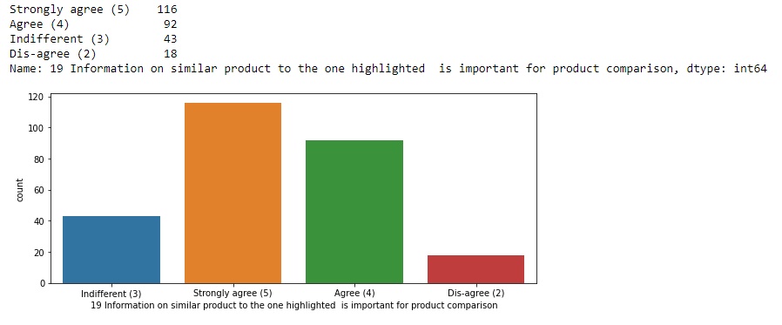
Need to focus to display the similar product for comparison

Slide 12
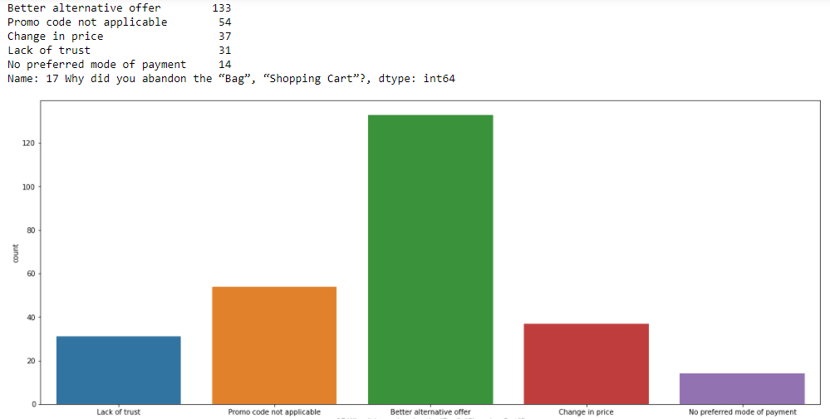
Most of the customers leave the item with making the payment due to Promo Code not available and Better alternative offer available on other platforms

Slide 13
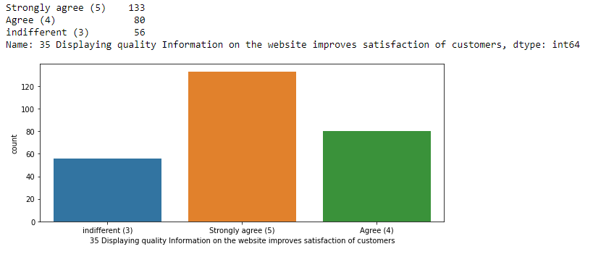
Have to display the quality information on the website to improve the satisfaction of customers

